Slide 1





Credit Card Approval Prediction

Slide 2
Contents
Introduction: Yuhyeon Seo
Data Cleansing: Jaehyun Lee
EDA: Yulie Yang
Data upscaling and dimension : Sangwon Seo
Machine Learning : Pengfei Ye

Slide 3



1.Introduction

Slide 4

Purpose
Detecting a risky user
-Approving a candidate
who cannot pay back
-Eliminating a good
candidate from the list
Figure 1. [https://brunch.co.kr/@01c796d7826e4f8/12]

Slide 5
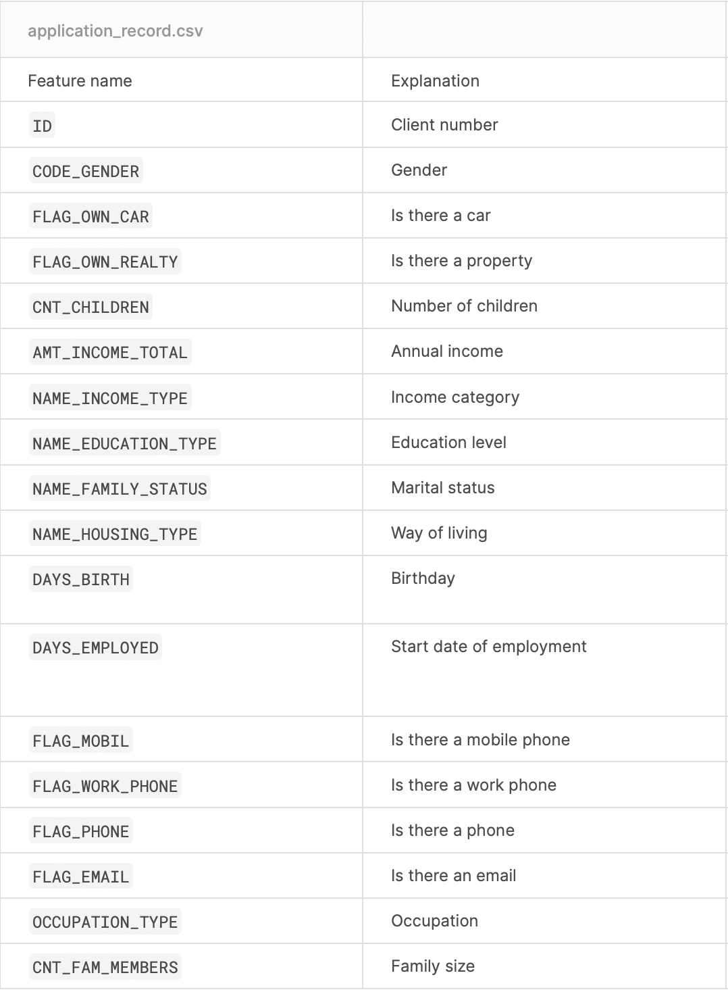
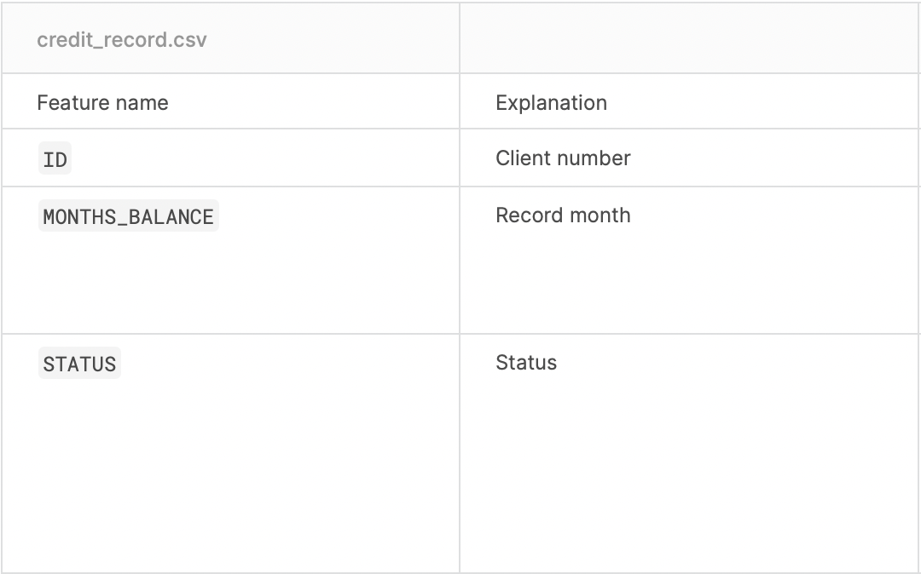
Data set(Kaggle)
-Credit Card Approval Prediction Dataset-

Slide 6
Expected Outcome
We expect to gain a clearer standard for deciding on approving credit cards.
This could lead to an increase in revenue and reduce the number of credit delinquents.

Slide 7
2. Data Cleansing

Slide 8
Dataset
application_record.csv
-> Personal info about customers (e.g. age, salary)
credit_record.csv
-> customers’ debt payment status

Slide 9
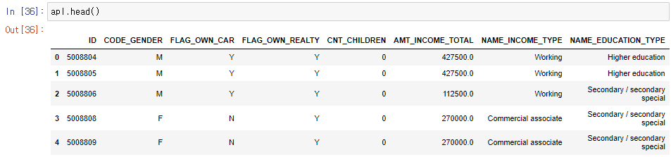
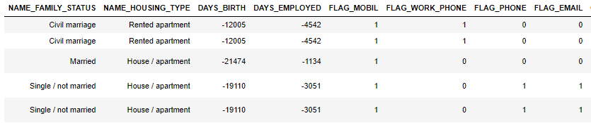
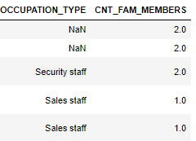
Necessity of Dataset Cleansing
application_record.csv

Slide 10
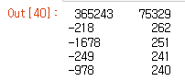
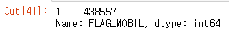
Necessity of Dataset Cleansing
application_record.csv

Slide 11
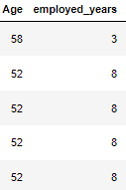
Necessity of Dataset Cleansing
application_record.csv

Slide 12
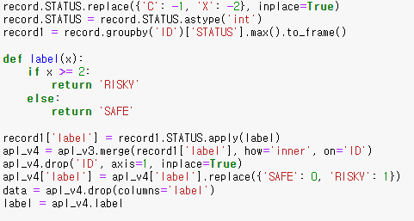
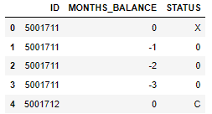
Necessity of Dataset Cleansing
credit_record.csv

Slide 13
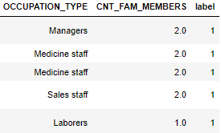
Necessity of Dataset Cleansing
credit_record.csv

Slide 14
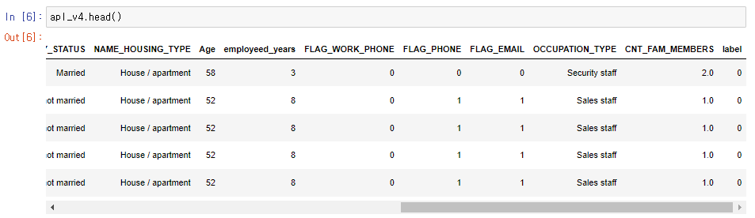
Final Dataset

Slide 15
3. Exploratory Data Analysis

Slide 16
Findings from Dataset
More females than males
More with realty
Most people do not have kid

Slide 17
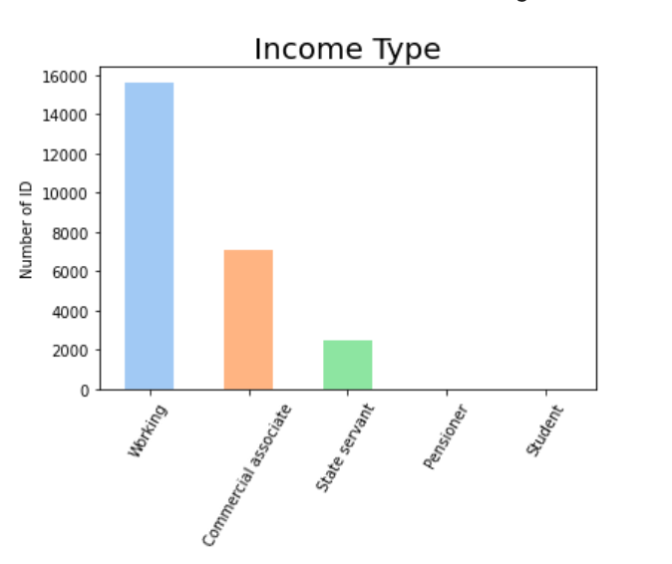
Income Type
Over a half was from working, and 23% was from commercial.

Slide 18
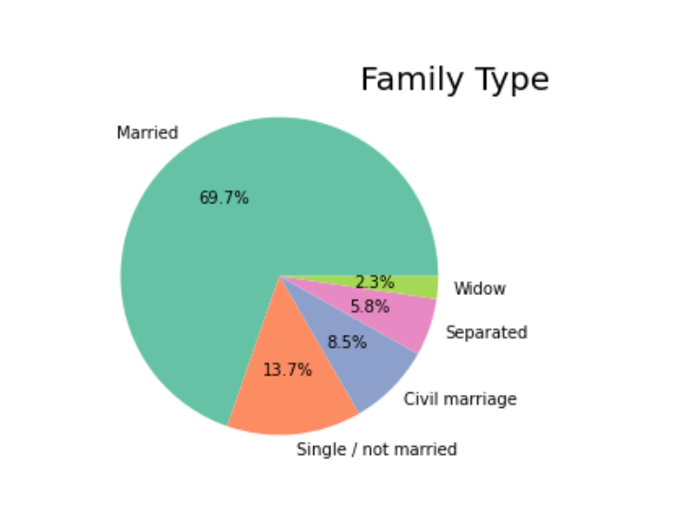
Family Status
Married counted for the most, about 70% and single came the second about 13%

Slide 19
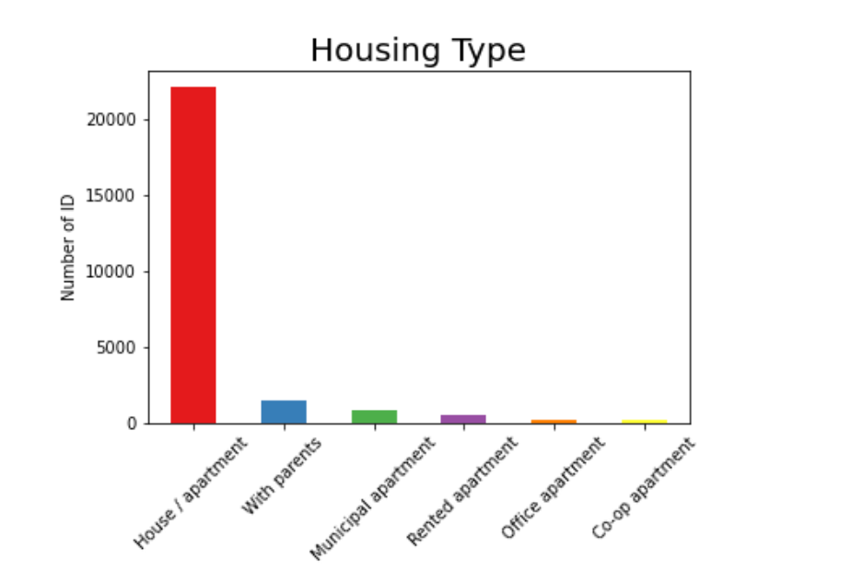
Housing Type
Most common type is apartment/house.

Slide 20
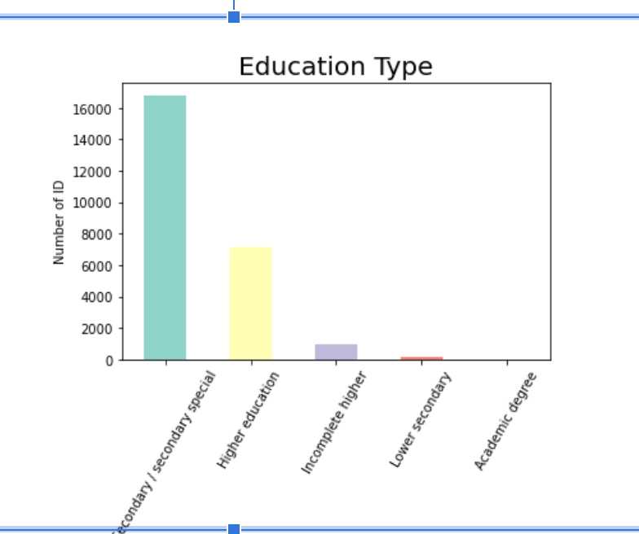
Education Type
Most people got the secondary.secondary special education

Slide 21
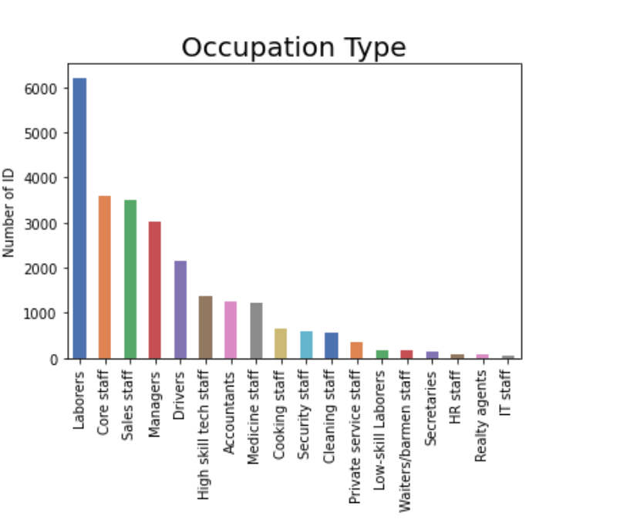
Occupation Type
Occupation types are diverse with laborers counted the most, for 31.1%.

Slide 22
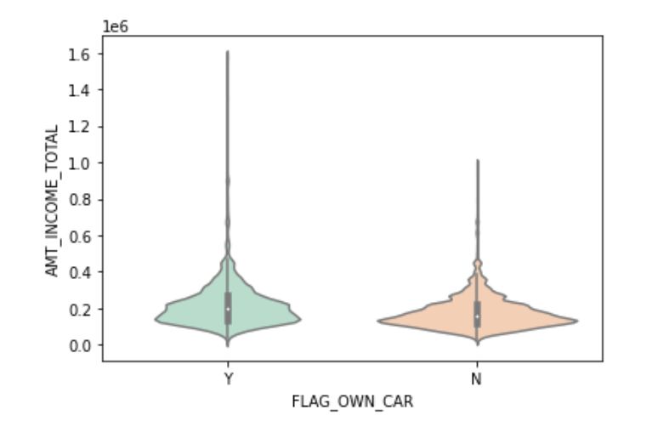
Car owner vs total income
Car owners have higher income.
It is apparent above 0.2 on y-axis.
The highest income is also from car owner.

Slide 23
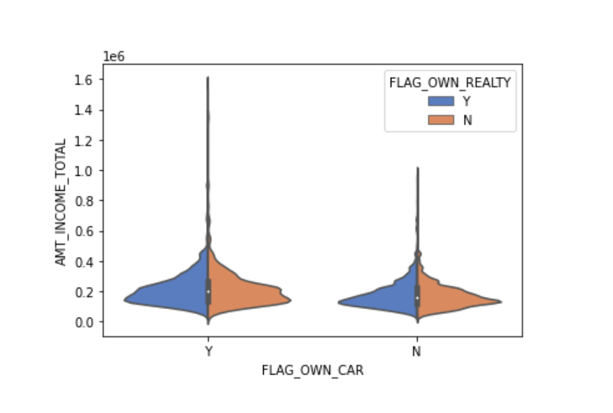
+Realty
Those with higher income have realty.

Slide 24
4. Imbalanced Data

Slide 25
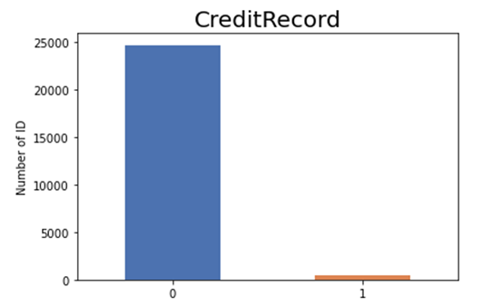
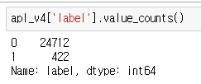
Imbalanced Data
Target class has an uneven distribution of observation
-> Majority Class 0 is much higher than Minority Class 1

Slide 26
Imbalanced Data
Goal is to predict Actual Risky applicants
-> True Positive value is too low
-> Imbalance Data causes this problem
 | Predicted: Risky | Predicted: Safe
Actual: Risky | True Positive | False Negative
Actual: Safe | False Positive | True Negative

Slide 27
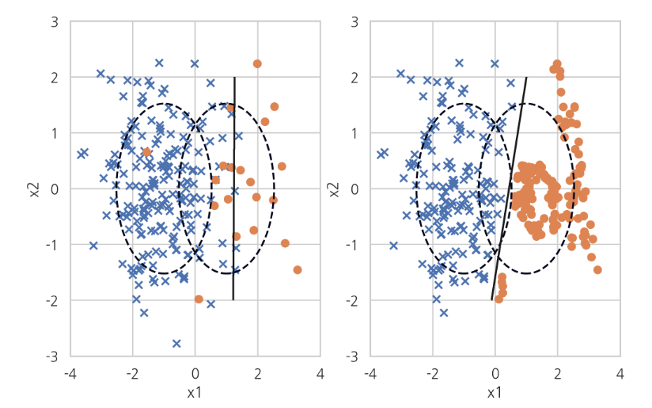
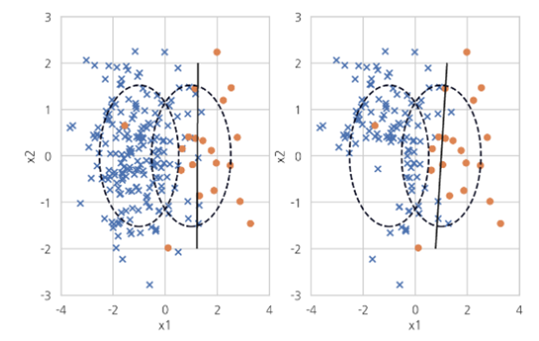
Handling Imbalance Data
Methods to handle imbalance data
-> Changing weight of each class
-> Oversampling and Undersampling
OverSampling
UnderSampling

Slide 28
5. Machine learning and deep learning model Implementation

Slide 29
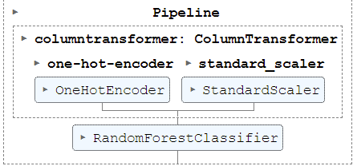
Machine learning data encoding
The data of credit card application is consisted of categorical and numerical data
The categorical data and numerical data are transformed using one hot encoder and standard scaler respective

Slide 30
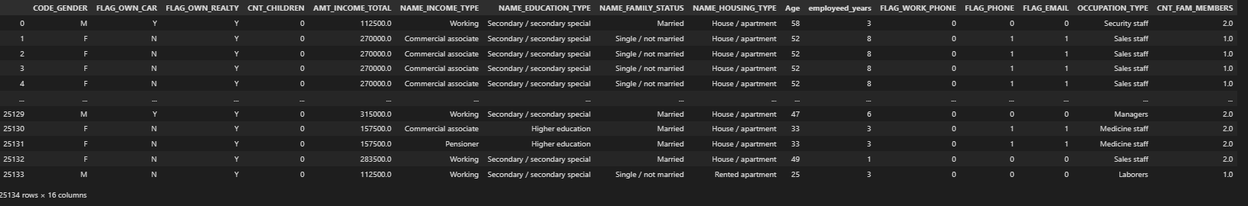
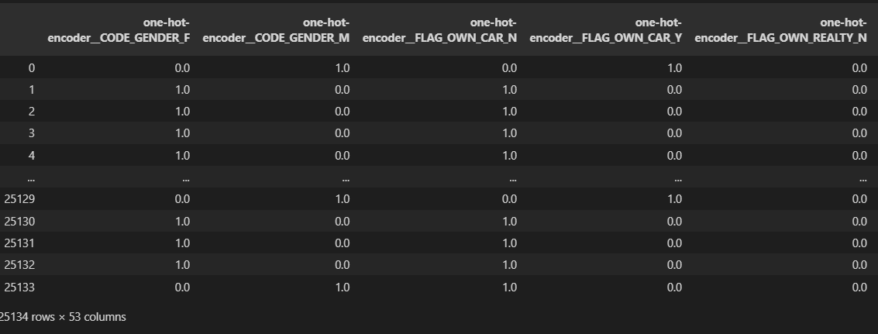
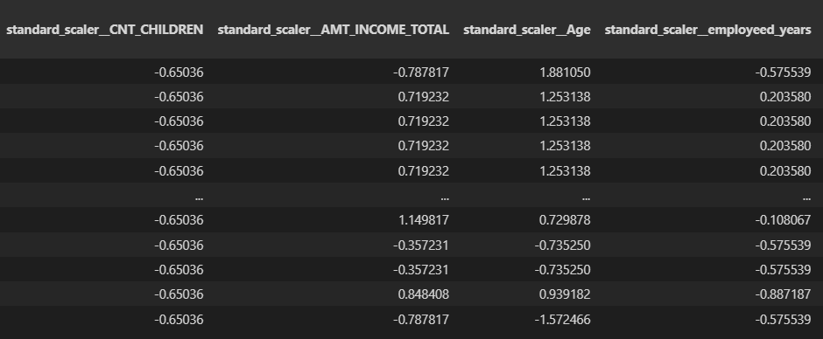
Machine learning data encoding
Before transformation
One hot encoder(Turn categorical data into 1 and 0)
Standard Scaler(Standardize numerical data)

Slide 31

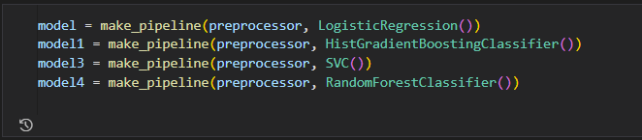
Machine learning data build
Using make pipeline data transformation and machine learning model integrated

Slide 32
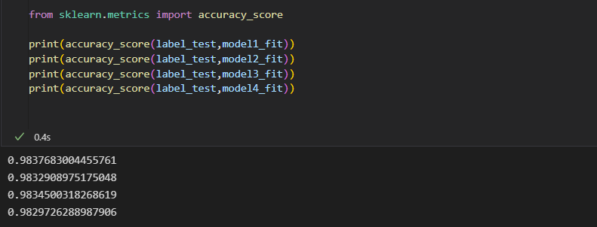
Machine learning results
Accuracy results:
98% accuracy!

Slide 33
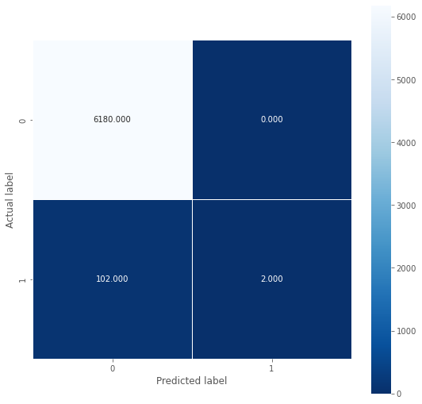


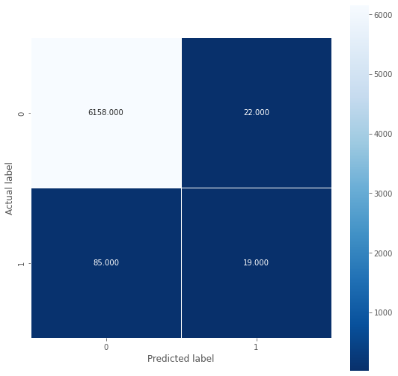
Machine learning results
Logistic
Regression
HistGradient
Boosting
Classifier
Random
Forest
Classifier
SVC

Slide 34
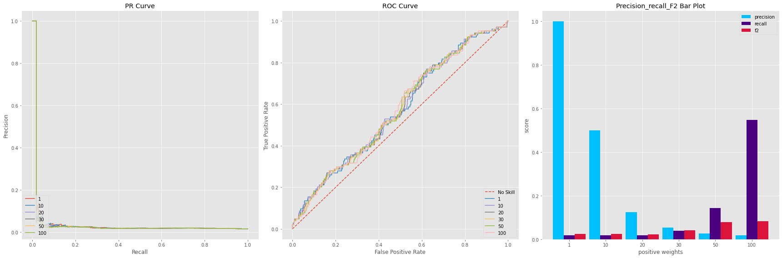

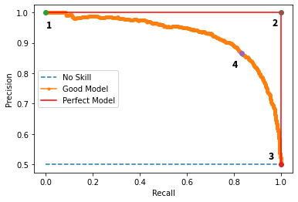
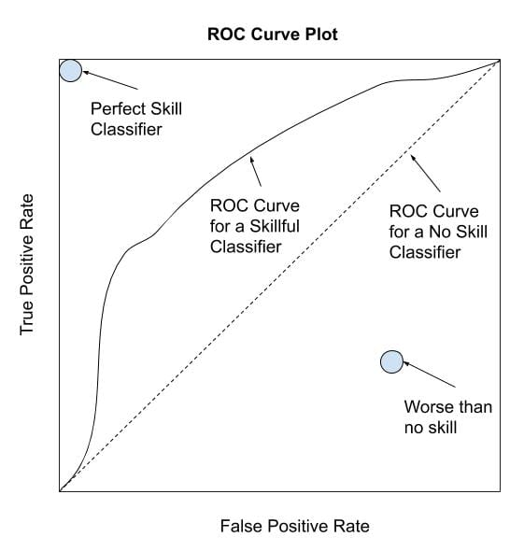
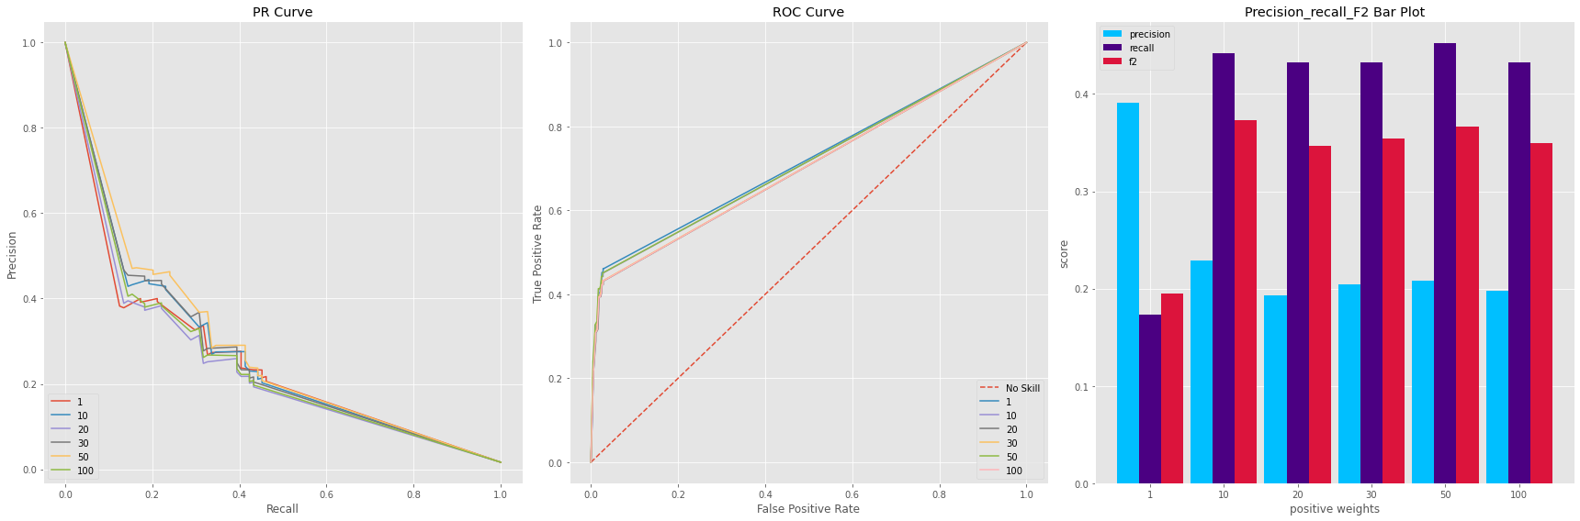
Machine learning results
Logistic regression
Decision tree

Slide 35
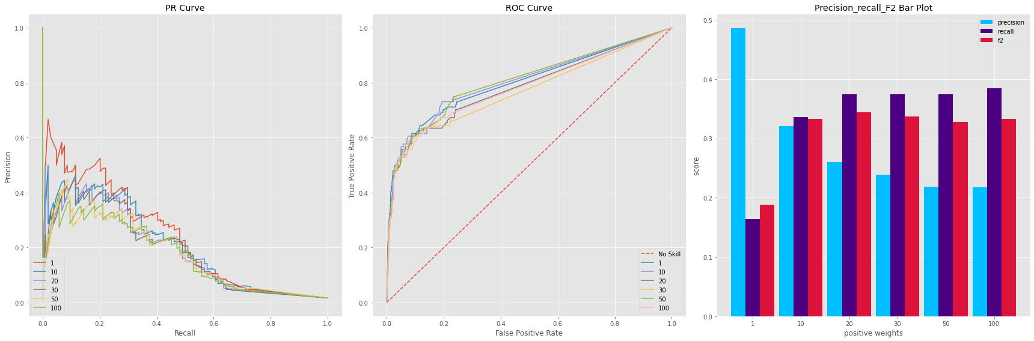
Machine learning results
RandomForestClassifier

Slide 36
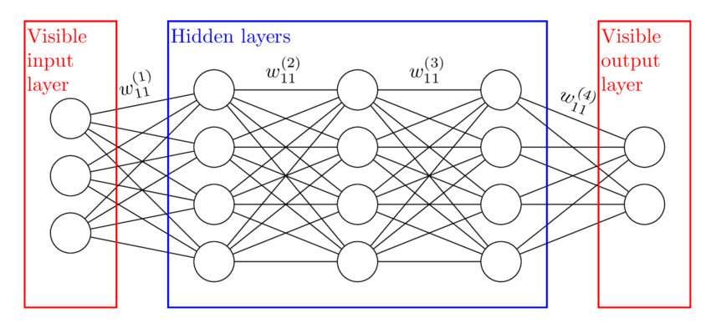
Deep learning
Binary classification with 3 hidden layers

Slide 37
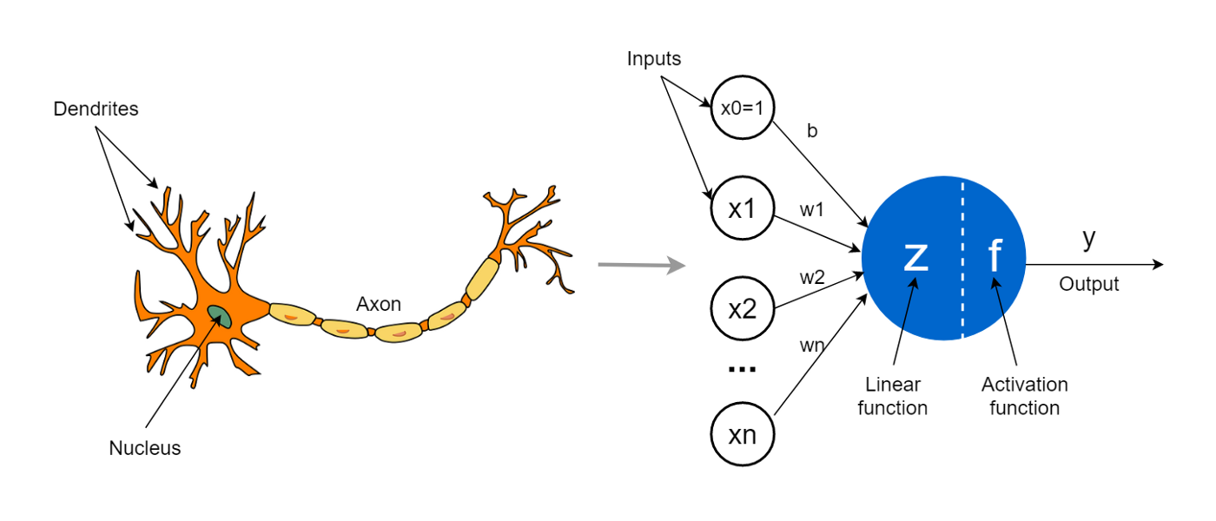
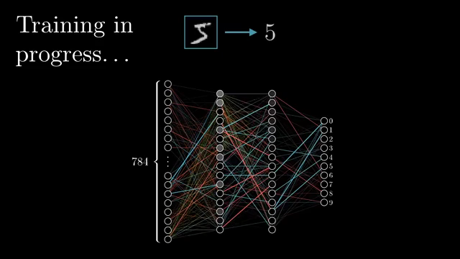
Deep learning neuron and backward propagation and forward propagation
Deep learning neuron analogy
Forward and backward propagation

Slide 38
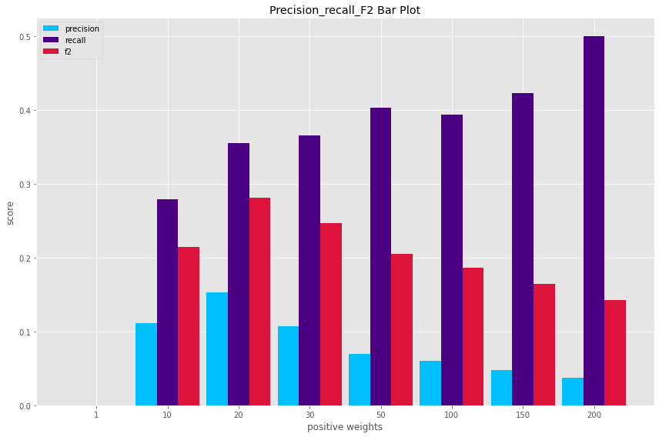
Precision_recall_F2 BAR PLOT WITH DIFFERENT WEIGHT

Slide 39
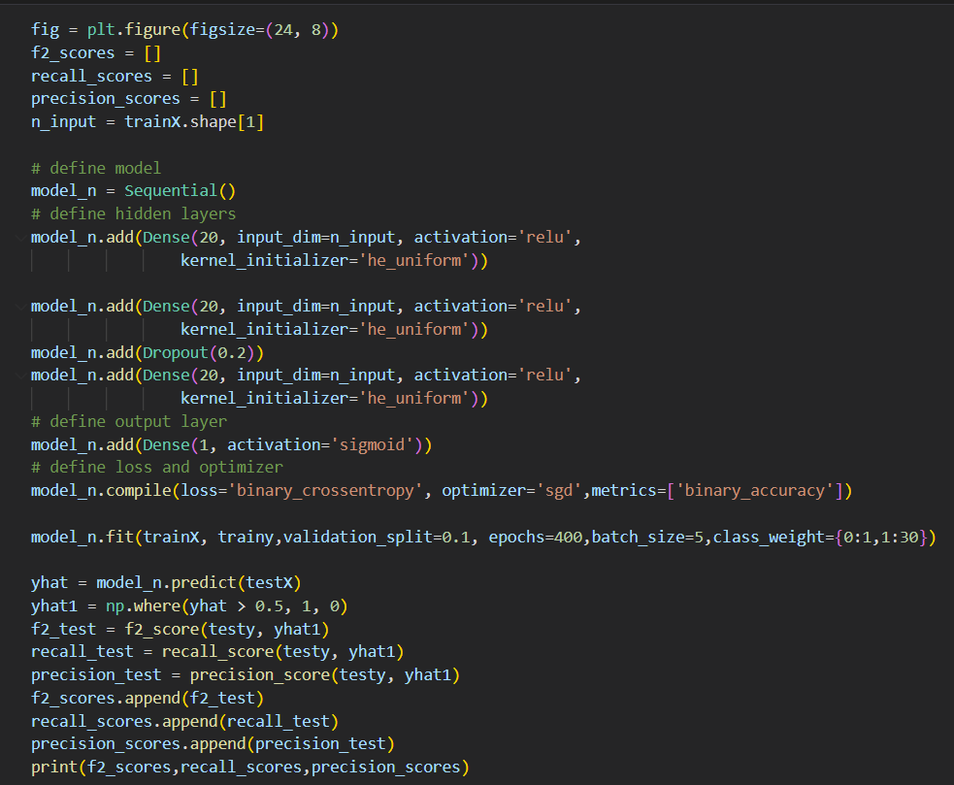
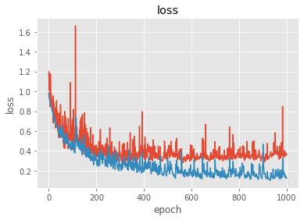
Final model
Red line: validation set
Blue line: training set

Slide 40
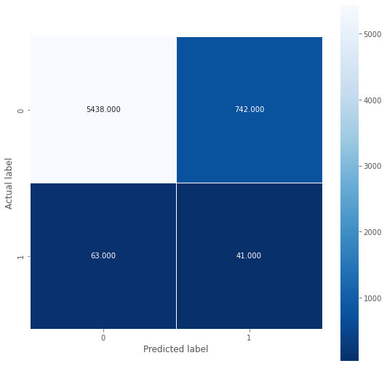
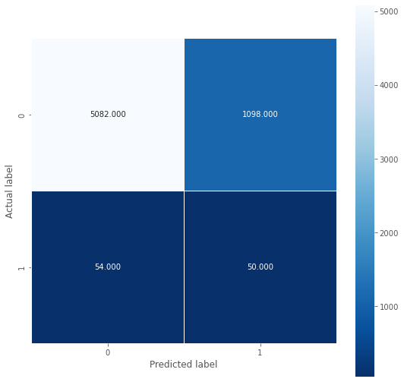
Deep learning results
CLASS WEIGHT=30,
BATCHSIZE=5,DROPOUT=0.1
CLASS WEIGHT=35,
BATCHSIZE=5,DROPOUT=0.1

Slide 41
Thank You

